Slide 1
I-40/Country club drive On-Ramp proposal
Maxxwell Townsend, Mohammed Alshaiban,
Zach Johnson, Ramon Lopez
CENE 476
December 6th, 2019

Slide 2
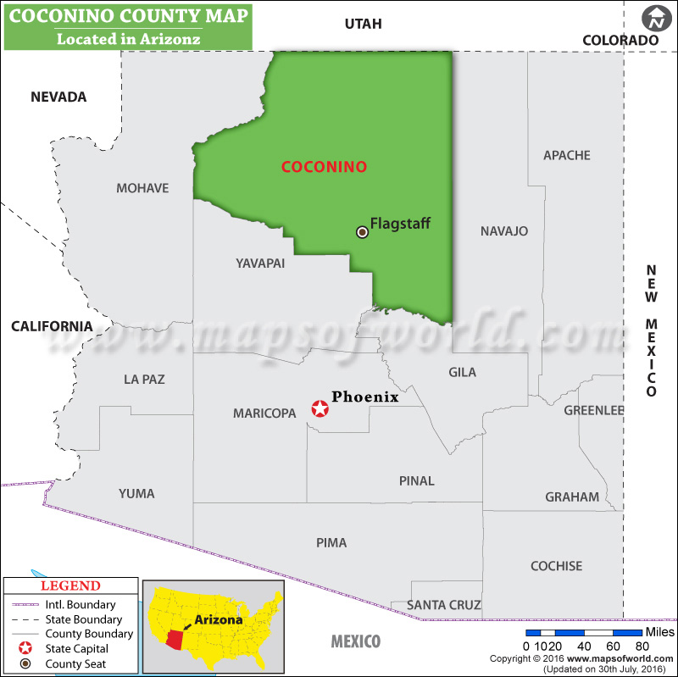

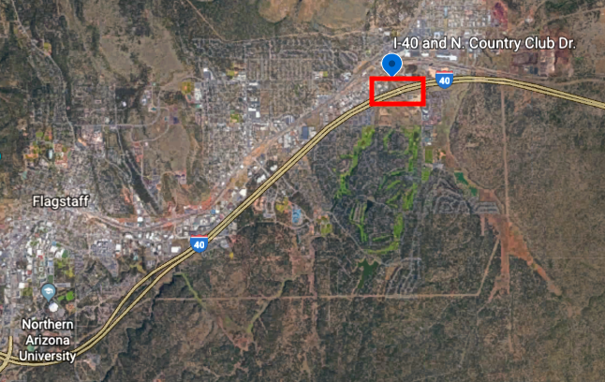
Project Location
The On-Ramp is located on N Country Club Drive adjacent to Interstate 40 in Flagstaff, AZ (shown in red)
Figure 2: City of Flagstaff Project Location (NTS) [2]
Figure 1: State of Arizona Project Location
(1” = 80 miles) [1]

Slide 3
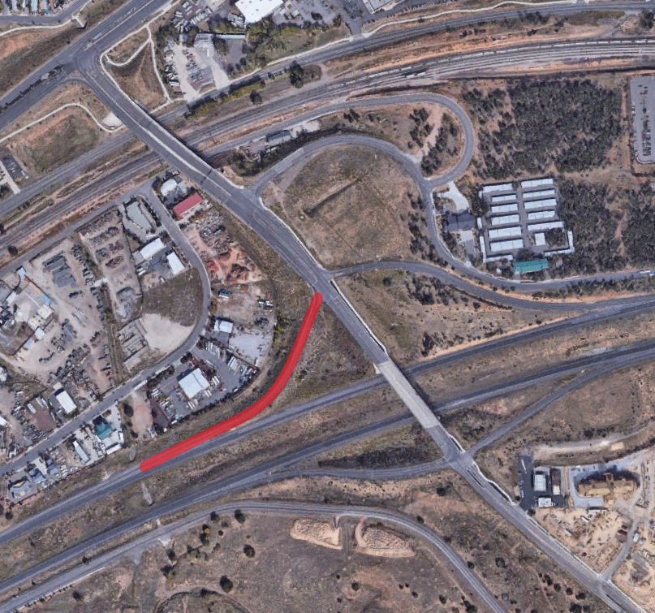
Project Purpose
One Southbound entrance onto I-40 westbound
Existing detention basin on north side
Adding an additional right turn lane to the on-ramp to increase capacity
Expand existing on ramp from 1 to 2 lanes to reduce congestion
Proposed Right Turn Lane
N Country Club Dr.
Ex. Detention Basin
I-40
Merging Lane
Figure 3: Zoomed in Project Location
(NTS) [2]

Slide 4

Stakeholders
Arizona Department of Transportation
Nate Reisner, P.E., Development Engineer
City of Flagstaff
Daily users of this facility
Figure 4: ADOT Logo [3]

Slide 5
Task 1: Analyze/Review Existing Studies
1.1 Site Visit
1.2 Process Survey Data from GIS
1.3 Analyze Existing Drainage Studies/Obtain As-Built Information
1.4 Existing Runoff Calculations
1.5 Obtain and Analyze Geotechnical Data from ADOT
1.6 Input and Process Existing Geometry into Civil 3D
1.7 Create Existing Cross Sections
1.8 Create Roadway Alignments/Base Files

Slide 6
Task 2: Design
2.1 Design/Create Proposed Cross-Sections
2.2 Initial Design
2.2.1 Intersection Design
2.2.2 On-Ramp Design
2.3 Final Design Geometry/Cross-Sections
2.4 Final Drainage Design
2.5 Stormwater Pollution Prevention Control Plan
2.6 Construction Plan Set
2.7 Synchro Analysis and Traffic Analysis Recommendation

Slide 7
Task 3: Deliverables
Task 4: Impacts
3.1 30% Submittal (Includes Task 1)
3.2 60% Submittal (Includes Task 1 & 2)
3.3 90% Submittal (Includes Task 1, 2 & 4)
3.4 Final Design Concept Report Submittal (Includes Task 1, 2 & 4)
3.5 Website
4.1 Economic Impacts
4.2 Environmental Impacts
4.3 Social Impacts

Slide 8
Task 5: Project Management
5.1 Grading Instructor Meetings
5.2 Client Meetings
5.3 Technical Advisor Meetings
5.4 Team Meetings
5.5 Schedule Management
5.6 Cost/Resource Management

Slide 9
Exclusions
Full Survey
Geotechnical Analysis
Collection of Traffic Data
Traffic Signal Planning
Environmental Permits/Mitigation Measures
Bridge Design
New Drainage Infrastructure Design

Slide 10
Critical Path shown in Red (70 Days)

Slide 11
Staffing
Table 1: Staffing Summary
Tasks | PM | PE | EIT | TECH | Total
Task 1: Existing Studies | 6 | 18 | 40 | 52 | 116
Task 2: Design | 17 | 38 | 98 | 74 | 227
Task 3: Deliverables | 9 | 16 | 42 | 30 | 97
Task 4: Impacts | 3 | 3 | 6 | 0 | 12
Task 5: Project Management | 42 | 42 | 38 | 38 | 160
Total | 77 | 117 | 224 | 194 | 612
612 Total estimated hours for this project
PE will lead Design Work
PM will review work and ensure QA/QC

Slide 12
Cost Estimate
Table 2: Cost Summary
1.0 Team Members | Billing Rate per Hour | Hours | Cost
PM | $195.00 | 77 | $15,015
PE | $155.00 | 117 | $18,135
EIT | $110.00 | 224 | $24,640
TECH | $75.00 | 194 | $14,550
Total |  |  | $72,340
2.0 Travel
8 Meetings @ 4 mi/meeting |  | $0.58 mi/meeting | $19
5 Meetings @ 2.5 mi/meeting |  | $0.58 mi/meeting | $10
Total |  |  | $29
Total Cost of Engineering Services |  |  | $72,369
Total Estimated Cost of Engineering Services is $72,369
Travel Cost is Minimal, but was Included for Accuracy

Slide 13
References
[1] “Coconino County Map” (2016). [Image] Available at: https://www.mapsoftheworld.com [Accessed 4 Dec. 2019].
[2] “Google Maps”, Google Maps, 2019. [2019]. Available: https://www.google.com/maps/@35.2171255.5857948.17z [Accessed 05- Dec- 2019].
[3] “Arizona Department of Transportation”, En.wikipedia.org. 2019. [Online]. Available:https://en.wikipedia.org/wiki/Arizona_Deparment_of_ Transportation [Accessed 05-Dec-2019]
[4] “AASHTO-Roadside-Design-Guidelines,” American Association of State Highway and Transportation Officials, vol. 4th, 2011
[5] “ADOT Roadway Design Guidelines,” Arizona Department of Transportation, May 2012

Slide 14
Questions?

